Slide 1
Group 5 Super Forecasting
Meera Duvvada, Amaryllis Gu, and Todd Robinson

Slide 2
Overview
Will Travis Kelce and Taylor Swift announce or acknowledge they are engaged to be married before May 10, 2024?
What percentage of the vote will the MORENA party candidate receive in the next Mexican general election for president?
When will Russia and Ukraine sign or announce an agreement to end the current conflict in Ukraine?

Slide 3
Will Travis Kelce and Taylor Swift announce or acknowledge they are engaged to be married before May 10, 2024?

Slide 4
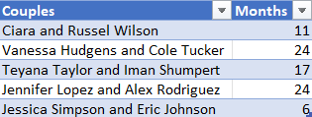
Bayesian Prior: How long did Musician-Athlete relationships take to get engaged?
The average time it takes for a Musician-Athlete relationship to get engaged is 16.4 months. If Travis and Taylor started dating in September, the likelihood of them getting engaged in 8 months is between 20-25%.

Slide 5
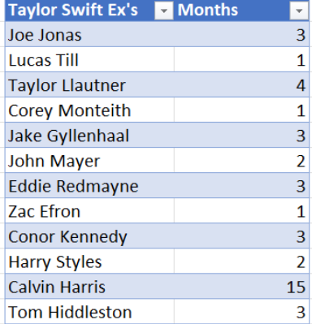
Taylor Swift’s Profile
Average relationship lasted 8.14 months
Decrease by 25%
20% → 15%
25% → 18.75%
Currently 34 years old
Less than half of women born in the 90s have babies before turning 30
Taylor Swift indicates she wants children preferably by her mid-30s
Add 5%
15% → 20%
18.75% → 23.75%

Slide 6

Final Forecast
The chances of Taylor Swift and Travis Kelce announcing or acknowledging they are engaged to be married before May 10, 2024 is between 20-23.75%. This means that they will probably not get engaged by May 10, 2024.

Slide 7
References
Balogun, T. (2023, November 27). Teyana Taylor and Iman Shumpert's Relationship Timeline. People. https://people.com/music/teyana-taylor-iman-shumpert-relationship-timeline/
Blanchard, S. (2022, January 27). Less than half of women born in '90s have babies before turning 30. The US Sun. https://www.the-sun.com/health/4557480/women-born-1990-under-half-have-baby-before-30/
Booth, J. (2023, August 30). Jessica Simpson and Eric Johnson's Relationship Timeline. People. https://people.com/music/jessica-simpson-eric-johnson-relationship-timeline/
Caruso, S. (2023, October 29). Ciara and Russell Wilson's Relationship Timeline. People. https://people.com/music/ciara-and-russell-wilson-relationship-timeline/
Desk, W. (2023, October 4). Taylor Swift plans to settle down, have kids amid Travis Kelce romance. Geo News. https://www.geo.tv/latest/513000-taylor-swift-plans-to-settle-down-have-kids-amid-travis-kelce-romance
Gibson, K. (2023, November 20). Taylor Swift and Travis Kelce's Relationship Timeline. People. https://people.com/taylor-swift-and-travis-kelce-relationship-timeline-7974203
Gibson, K. (2023, November 30). Vanessa Hudgens and Cole Tucker's Relationship Timeline. People. https://people.com/tv/vanessa-hudgens-and-cole-tucker-relationship-timeline/
Weisholtz, D., & Jeffrey, J. (2023, October 27). Ciara and Russell Wilson's Relationship Timeline. The Today Show. https://www.today.com/popculture/music/ciara-russell-wilson-relationship-timeline-rcna111362
Wurzburger, A. (2021, April 15). Jennifer Lopez and Alex Rodriguez's Relationship Timeline. People. https://people.com/music/jennifer-lopez-alex-rodriguez-relationship-timeline/

Slide 8
What percentage of the vote will the MORENA party candidate receive in the next Mexican general election for president?

Slide 9
Bayesian Prior: Parties that won their firs election and their year 2 voting %
La République En Marche (France)
Justice and Development Party Turkey
Founded in 2001, Won 2002, 46.58% in 2007 (+12.3%)
Syriza (Greece)
Founded in 2012, Won 2015, 31.53% in 2019 (-4.81%)
Law and Justice (Poland)
Founded 2001, Won 2005, 32.1% in 2007 (+5.1%)
Founded in 2016, Won 2017, 58.55% in 2022 (-7.55%)
Based on these four elections, a party that wins its first election on average increases its votes by 1.26%. The MORENA party got 54.71% of the vote in the 2018 general election. We can forecast that they will get 55.4% of the vote in the upcoming election.

Slide 10
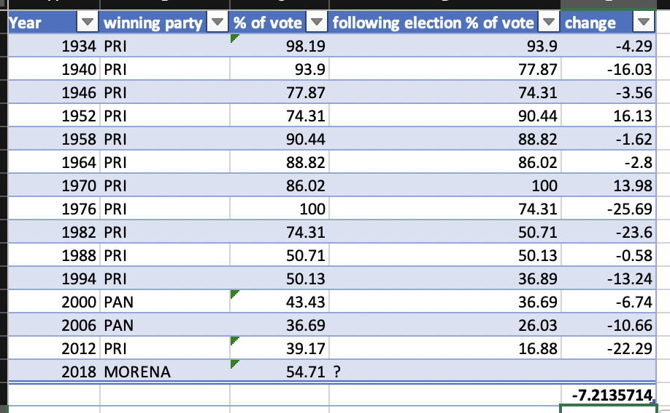
MORENA Historical Data
What do the polls say?
As of November 2023, the MORENA party has 42% of the polling votes
In the 2018 polls, the MORENA party had 36.2% of the votes and ended with 53.1% of the total votes. That’s a 16.9% increase
If this trend repeated itself in 2024 MORENA will receive 58.9% of the votes
How have past winners done in following elections?
Since 1934, on average the winning party lost 7.2% of the vote the following year
If this trend continues MORENA party would get 45.9% of the votes in 2024

Slide 11
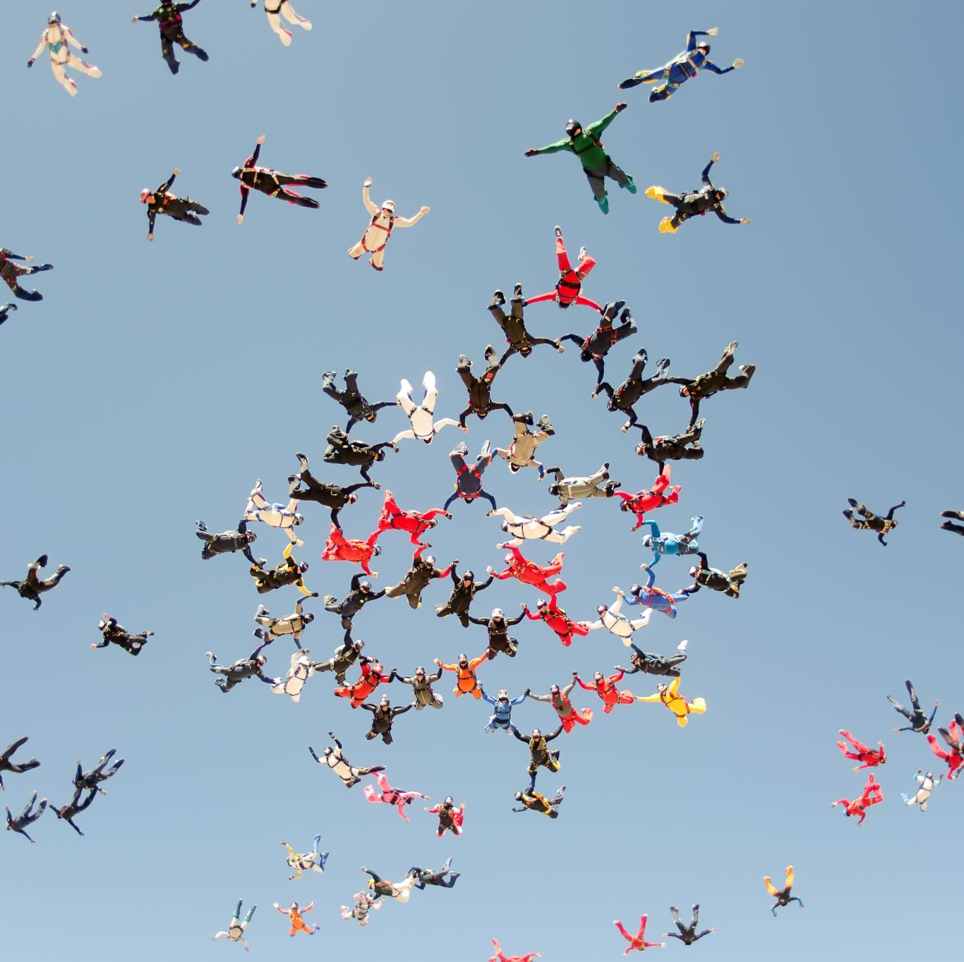
Final Forecast
Based on the prior and the question clusters it is almost certain that the MORENA party will receive between 49.5% and 58.9% of the votes in 2024 Mexican General Election. If we average the three percentages, we can say that the chances are about even that the MORENA party will receive 53.4% of the vote.

Slide 12
References
January 2015 Greek legislative election. (2023, September 13). Wikipedia. http://en.wikipedia.org/wiki/January_2015_Greek_legislative_election
Mexico Election 2018: A Historic Vote across the Nation. (2018, June 25). Wilson Center. http://www.wilsoncenter.org/event/mexico-election-2018-historic-vote-across-the-nation
2018 Mexican general election. (2023, October 24). Wikipedia. http://wikipedia.org/wiki/2018_Mexican_general_election
2022 French presidential election. (2023, November 19). Wikipedia. http://en.wikipedia.org/wiki/2022_French_presidential_election
2005 Polish parliamentary election. (2023, November 27). Wikipedia. http://en.wikipedia.org/wiki/2005_Polish_parliamentary_election
2002 Turkish general election. (2023, July 23). Wikipedia. http://en.wikipedia.org/wiki/2002_Turkish_general_election
Zissis, C. (2023, November 29). Poll Tracker: Contenders for Mexico's 2024 Presidential Vote. AS/COA. http://www.as-coa.org/articles/poll-tracker-contenders-mexicos-2024-presidential-vote

Slide 13
When will Russia and Ukraine sign or announce an agreement to end the current conflict in Ukraine?

Slide 14
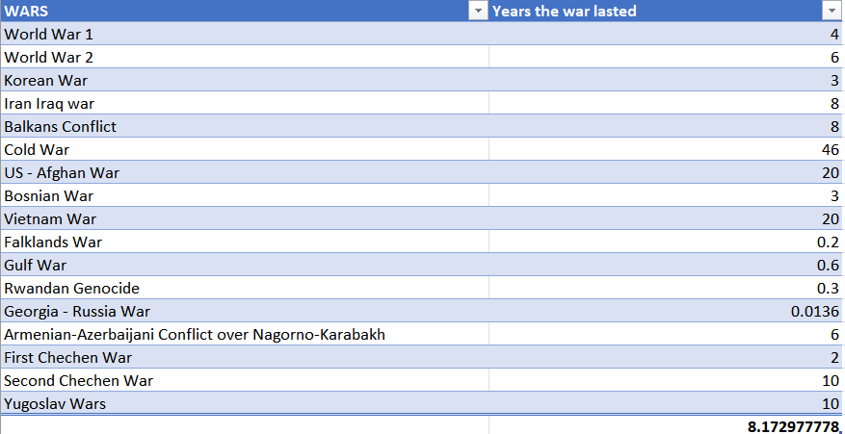
Bayesian Prior: Analyzing the past conflicts of similar nature and understanding their resolutions. In how many years did they sign or announce an agreement to end the conflict?
Average duration of similar conflicts: 8.65 years
High variability in conflict durations indicated by a standard deviation of 11.07 years
Notes:
Based on the historical conflict duration data, the prior value for the average duration of a conflict is:
Mean (μ): 8.65 years
Standard Deviation (σ): 11.07 years
This prior suggests that, conflicts have a wide range of durations but tend to average around 8.65 years. The large standard deviation indicates that there is a lot of uncertainty and variability in conflict durations.

Slide 15
Current Conflict Duration Comparison
Russia-Ukraine conflict duration (as of 2023): ~ 9 years
Probability of conflicts lasting 9 years or less: 51.26%
Probability of conflicts exceeding 9 years: 48.74%
Implication: Equal chance of the conflict ending soon or continuing
Notes:
Russia-Ukraine conflict (2014 to 2023 ongoing) ~ 9 years in duration.
What is the probability that conflicts similar to the Russia-Ukraine conflict would have lasted at least as long as the Russia-Ukraine conflict has?"
Probability that conflict would last 9 years or less ~ 51.26%.
Probability that a conflict would last more than 9 years ~ 48.74%.
The current duration of the Russia-Ukraine conflict —> 9 years —-> close to the median duration of historical conflicts.
It suggests that, if the Russia-Ukraine conflict were an average conflict, there would be roughly an equal chance of it ending soon as there would be of it continuing based on the duration alone.

Slide 16
Likelihood of Conflict Ending Within Next Year
Post-escalation (post-September 2022) mean duration update: 10.38%
Probability of conflict ending within the next year: 48.63%
Notes:
Probability of the conflict duration being less than or equal to the current duration plus one year.
After the “Counteroffensive and Recapture of Territories (September 2022)” escalation (20% increase in duration in reaching resolution)
Updated mean → 10.38 years
Based on the updated mean duration of conflicts due to the assumed escalation (10.38 years), the likelihood of the Russia-Ukraine conflict ending within the next year (making the conflict last 10 years in total) ~ 48.63%.

Slide 17

Final Forecast
When combining these insights with the previously calculated Bayesian prior, we can infer that the Russia-Ukraine conflict is at a juncture where it could either end soon or continue for an extended period, as some conflicts historically have.
Notes:
Likelihood of the conflict ending within the next year: Based on the updated mean duration due to the assumed escalation, there is roughly a 48.63% chance that the conflict could end within the next year, given the prior distribution.
Comparison with historical average: The current duration of the Russia-Ukraine conflict is close to the historical median duration of conflicts, which suggests that it is at a point where many historical conflicts have either ended or continued for a significantly longer period.

Slide 18
References
History. (2009, October 29). Vietnam War. Vietnam War: Causes, Facts & Impact. https://www.history.com/topics/vietnam-war/vietnam-war-history
Kusa, I. (2023, November 8). What Does the Conflict in the Middle East Mean for Ukraine? Carnegie Endowment for International Peace. https://carnegieendowment.org/politika/90945
Shah, H. A. (2021). "There are obvious parallels between Ukraine and Palestine — despite the mainstream media coverage". Islam Channel. https://www.islamchannel.tv/blog-posts/there-are-obvious-parallels-between-ukraine-and-palestine-despite-the-mainstream-media-coverage
Trofimov, Y. (2023, December 1). Essay | Does the West Have a Double Standard for Ukraine and Gaza?
The Wall Street Journal. https://www.wsj.com/world/does-the-west-have-a-double-standard-for-ukraine-and-gaza-81f72163
Ukraine-Palestine Solidarity Group. (2023, November 8). Ukrainian letter of solidarity with the Palestinian people. Al Jazeera. https://www.aljazeera.com/opinions/2023/11/8/ukrainian-letter-of-solidarity-with-the-palestinian
U.N. Resolution on Chechnya Welcomed. (2001, April 19). Human Rights Watch. https://www.hrw.org/news/2001/04/19/un-resolution-chechnya-welcomed

